Slide 1

Used cars
A Model to predict used car prices for sale based on features
Ilana Zaitsev 318358744
Ofir avioz 313533812

Slide 2

Cars are great!
But deciding whether a used car is worth the posted price can be difficult.
The average car loses 35 percent of its value in the first three years of its life. which is great news for driver, shopping for a good deal on the used market.
In addition, from the perspective of a seller, it is also a dilemma to price a used car appropriately.

Slide 3

There are several factors, including kilometers, number of hands, model, year, etc. can influence the actual worth of a car.
Based on existing data, the aim is to use machine learning algorithms to develop models for predicting used car prices.

Slide 4

Crawling
data source-Komo.co.il

Slide 5

Step 1
The site shows maximum 10 pages of data for each filter.
We found base URL for filtered pages based on all manufacturers and the years 2001-2021
From the base url we extracted the number of pages.
From each page we extracted listing id number.

Slide 6

Step 2
We found the url for each specifying listing
We used the listing id to access each listing
we extracted all the data we needed:
Kilometers ,model, price ,year ,hand , engine size, last owner, current owner and gear box.

Slide 7
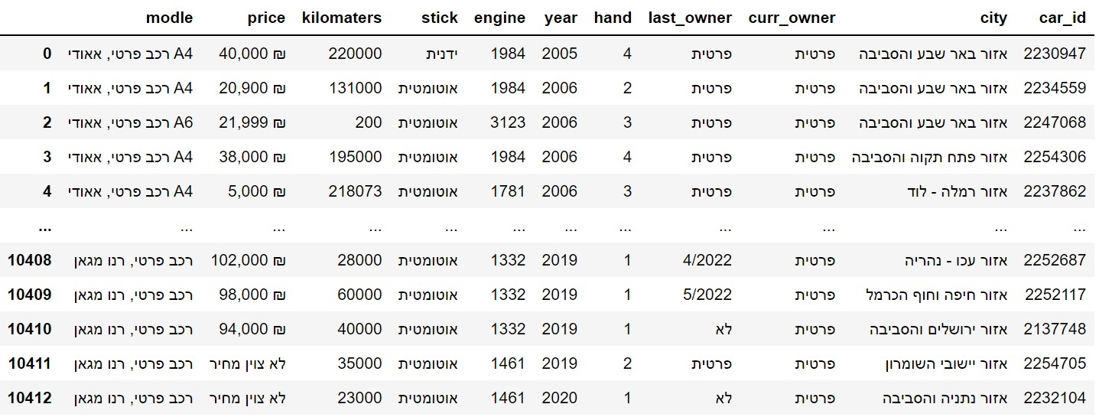
Our data frame:

Slide 8

Data cleaning

Slide 9
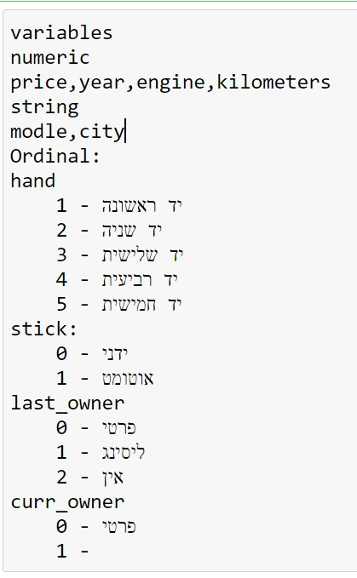
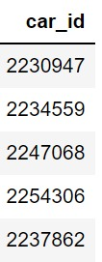
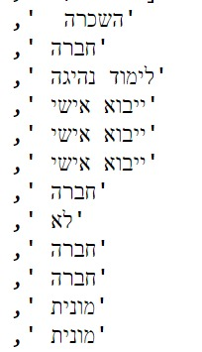
Understanding the data:
Data Types, missing data, mean, unique, frequency, count, etc.
Duplicates:
We made sure that we don’t have duplicated data
Using unique identifier->
Data handling:
Replacing all gears that aren't manual into auto gear category.
Removing listing cell in which the cars weren’t private or leased->

Slide 10
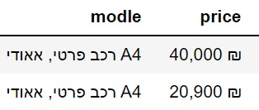
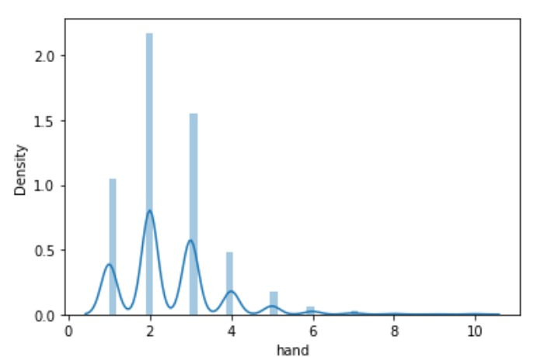
noise data:
Cleaning unnecessary signs and words
Missing Data :
Removing empty cells and listings with non provided price
outliers:
We have noticed that we have only 5%
of cars that exchanged more then 4 hands
We have noticed that we have handful
of cars that cost more than 500k
We have noticed that we have handful
of cars that their engine is bigger then 5k.
We removed all the outliers

Slide 11
Data handling and preparation
Changing string values to numeric values
Creating a new numeric columns of brand and brand category.
Brand: the car’s brand
Brand category: budget, mid range, luxury.

Slide 12
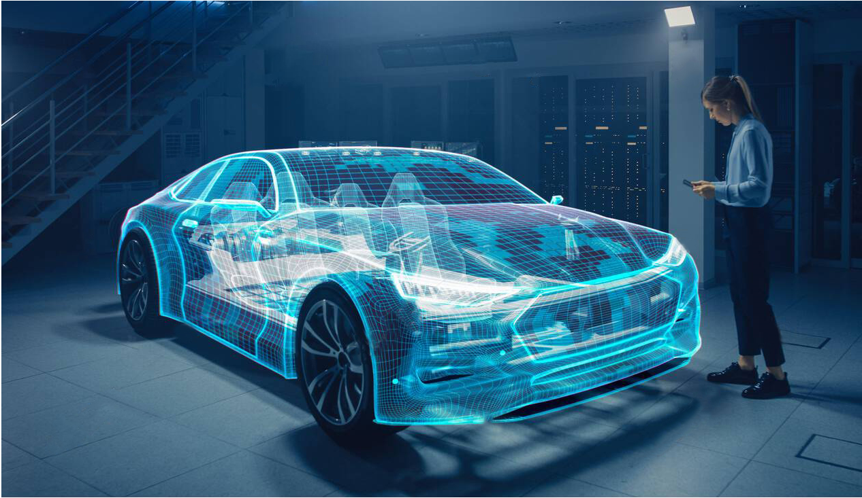
visualization

Slide 13
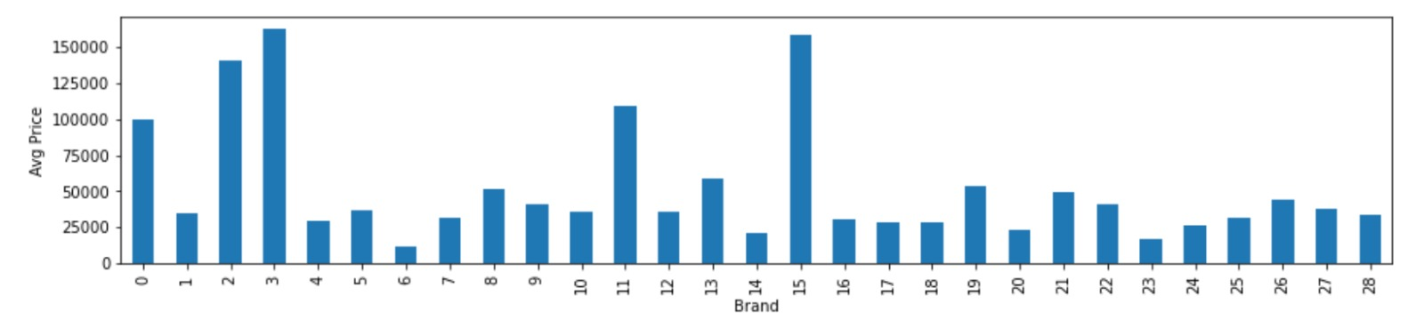
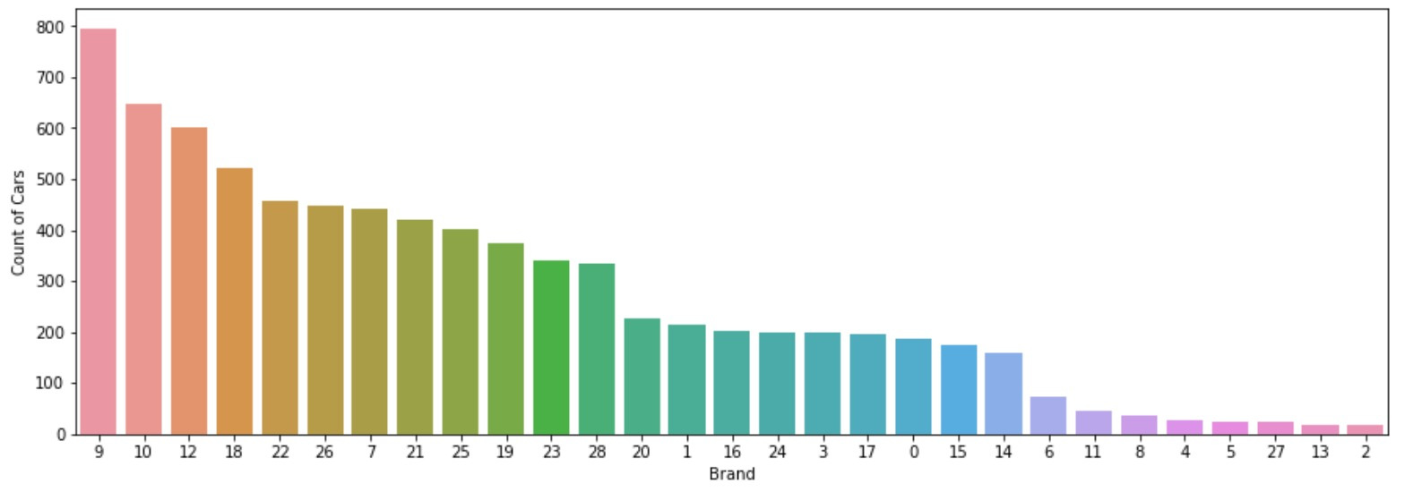
Average price vs brand
We used this chart to create brand category
Count of cars vs brand

Slide 14
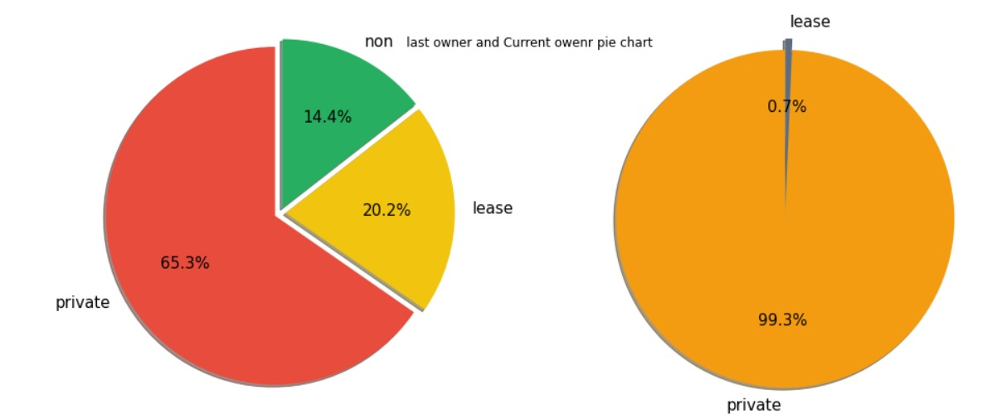
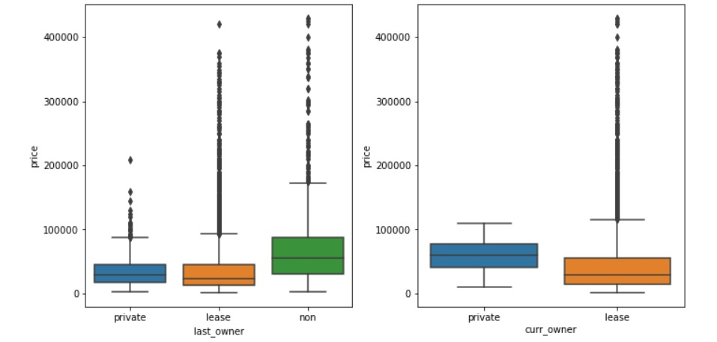
Pie chart of last owner and current owner
Price vs last owner
Price vs current owner

Slide 15
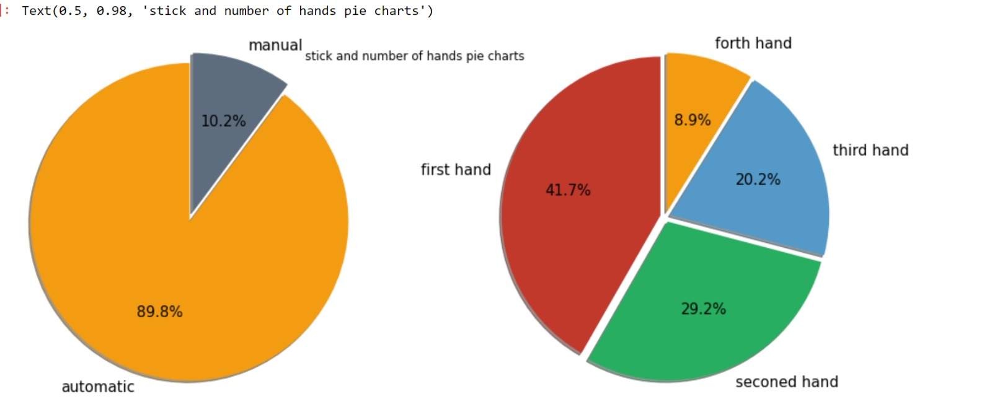
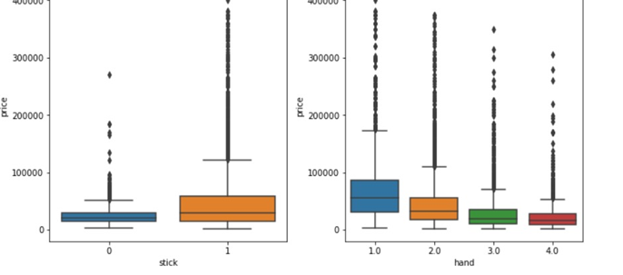
gear box(stick) and hand:

Slide 16
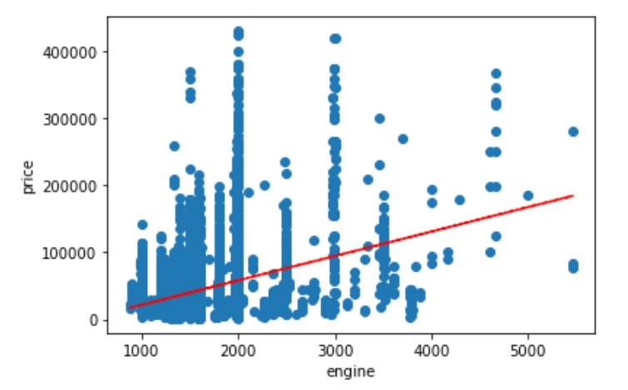
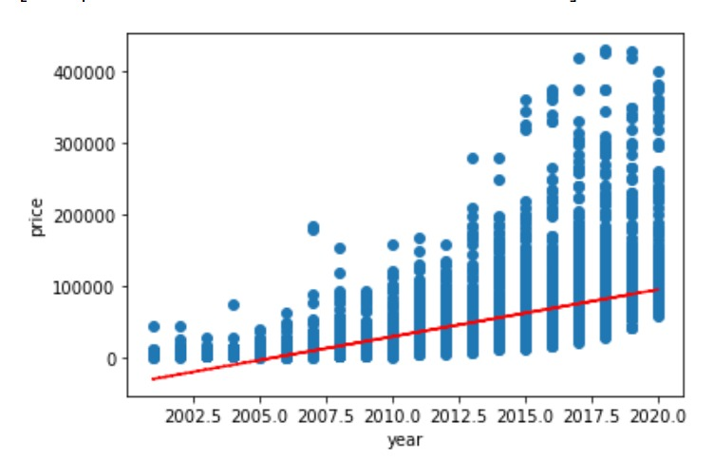
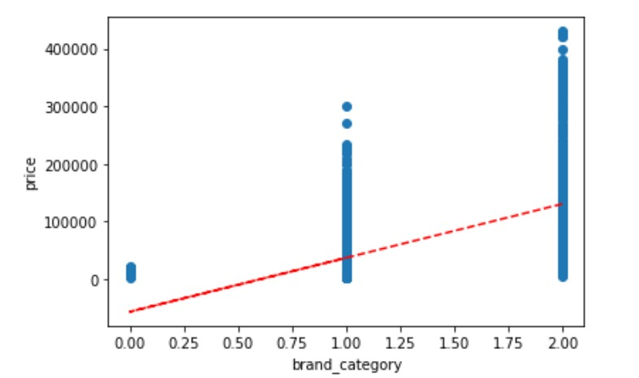
We can see a positive linear relationship between the engine ,brand category and year with the price category:

Slide 17
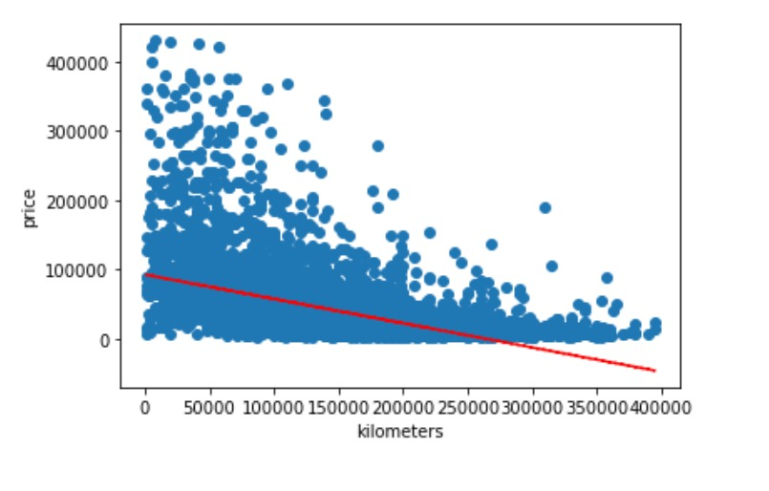
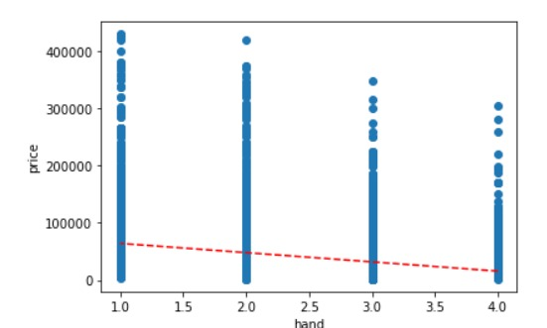
We can see a negative linear relationship between the hand and year category with the price category:

Slide 18

Machine learning
Our independent variable – price is a Continuous variable.
Meaning, our problem is a regression problem, so we used linear regression algorithms

Slide 19
Our label is price column because are our research question refers to predict the price of a used car based on the fetchers we have presented.
We used linear regression – supervised learning (by ordinary least squares and RFE method).
What is ordinary least squares (ols)?
OLS is the method used to find the simple linear regression of a set of data and estimating the relationship between one or more independent variables and a dependent variable.
What is Recursive feature elimination (RFE)?
RFE is a feature selection method that fits a model and removes the weakest feature (or features) until the specified number of features is reached.
before feature engineering, we got accuracy of 45% Our final mode accuracy is 63%

Slide 20
Step 1: We applied machine learning process:
Dividing our data frame: features and label (status).
Dividing features and label to train and test (train = 70%, test = 30%).
We ran RFE method to save only 3 strong variables.
We ran the linear regression (ols) method and checked the p values to verify the strength of the remaining variables
Fit & Predict
Accuracy
Step 2: Feature Engineering:
We dropped the model and brand columns and created a new column- brand category.
Removing all columns except the 3 most significant using RFE system
p value< 0.05= the category has meaningful relationship with the label

Slide 21

conclusion
We can see that the features with the most positive effects on car price are engine , year and brand category.
We can see that the features with the most negative effects on car price are kilometers , hand number and last owner.
We can see the average price between cities in Israel is the same for most areas except קיסרה""

